Slide 1


KKBOX & Spotify
KKBOX & Spotify
GROUP 5
Music
Recommendation
System
Darren Jacky Gemma Tristan

Slide 2

TABLE OF CONTENTS
01
04
02
05
03
PROJECT OVERVIEW
IMPROVEMENTS &
CONCLUSION
EDA & RESULTS
THOUGHTS &
DISCUSSION
LIMITATIONS

Slide 3

01
PROJECT OVERVIEW
Project Aims
&
Business Values

Slide 4


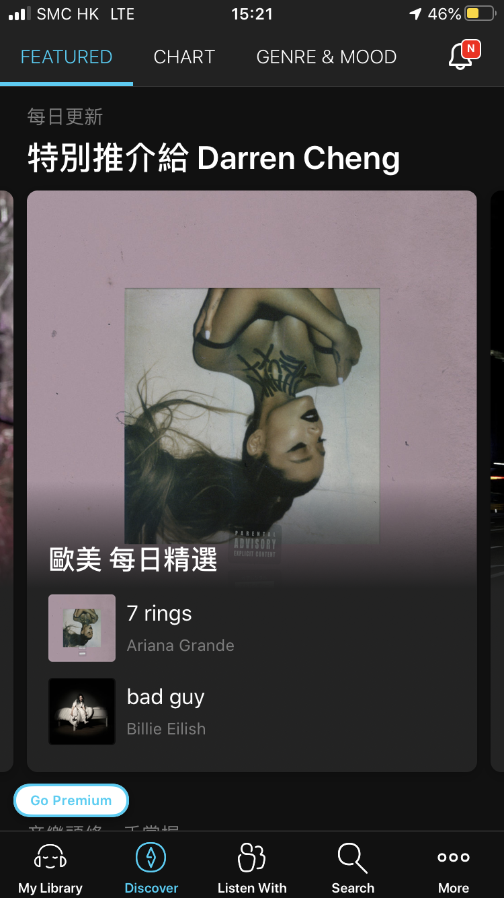
BUSINESS VALUES
Spotify | KKBOX
“Discover Weekly” | “Special recommendation (Genre)”
“Made for you” | “Based on this, you may like this..”
“Uniquely yours” | “Unheard thunderbolts”
“Release Radar”

Slide 5

PROJECT AIMS
1.
2.
To understand how platforms we use recommend songs
Develop insights through comparing global and aisan music streaming platforms (Limit 2)

Slide 6


DATASETS
SPOTIFY
KKBOX
Swedish-based audio-streaming provider
Features including:
Discover Weekly
Daily Mixes
Datasets includes 1 million playlists
Taiwan based, Asia's leading music streaming service,
Datasets include Each user’s listened songs → categorized as listened once/more than once

Slide 7

02
EDA & RESULTS
This is the subtitle that makes it comprehensible

Slide 8
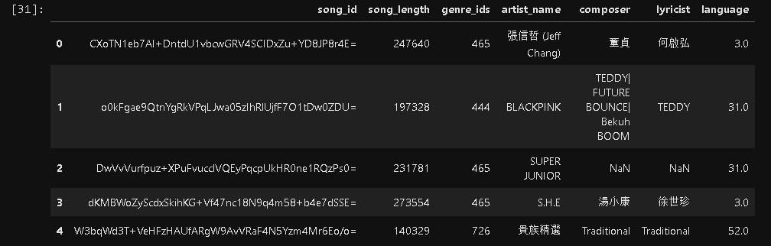
EDA

Slide 9
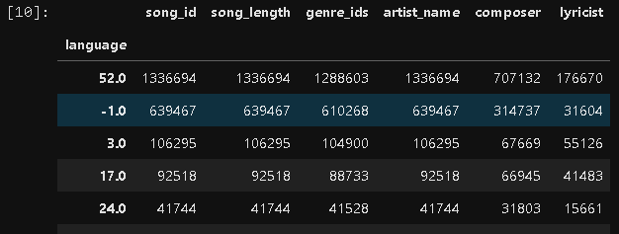
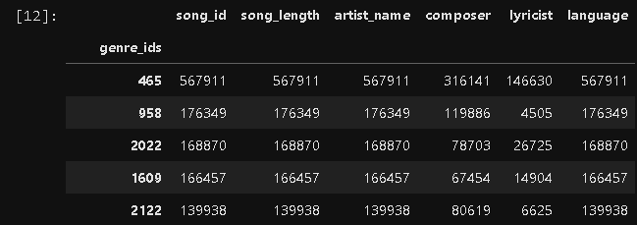
EDA

Slide 10
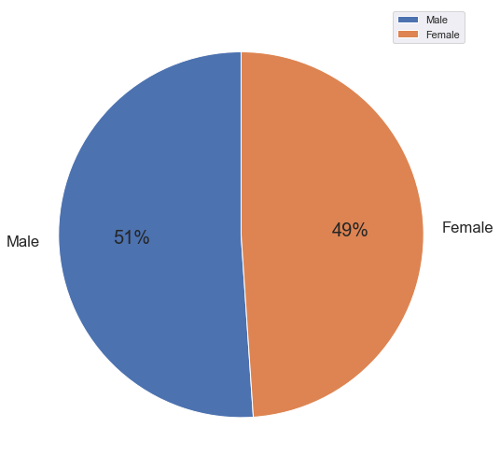
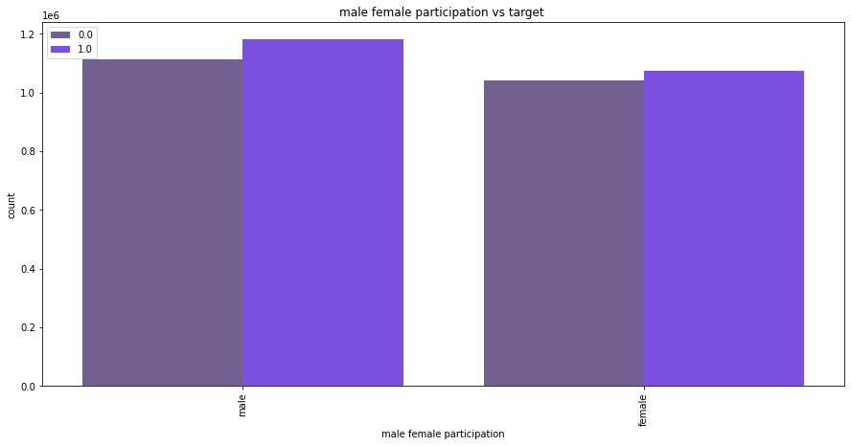
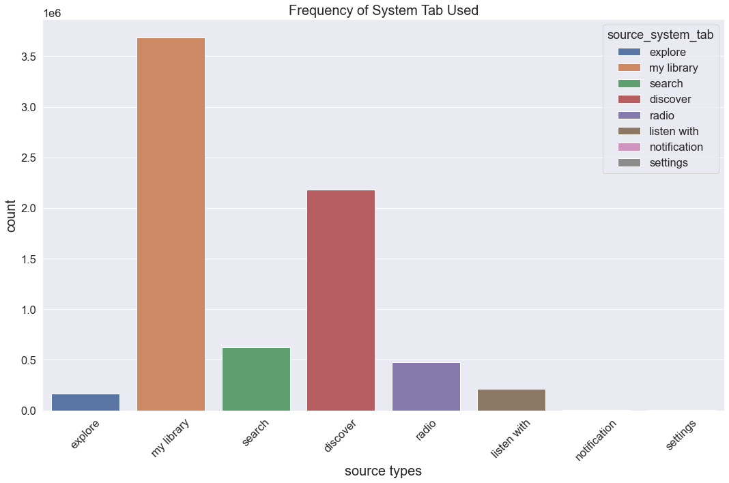
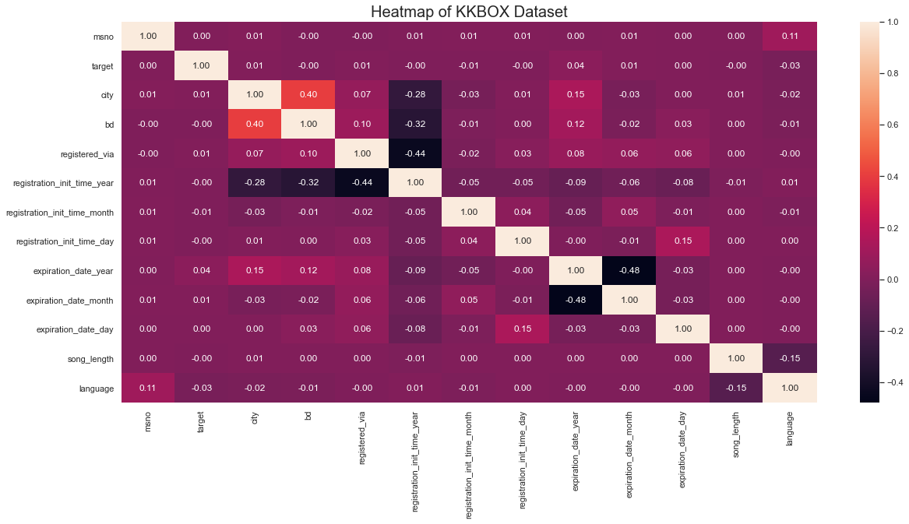
EDA

Slide 11
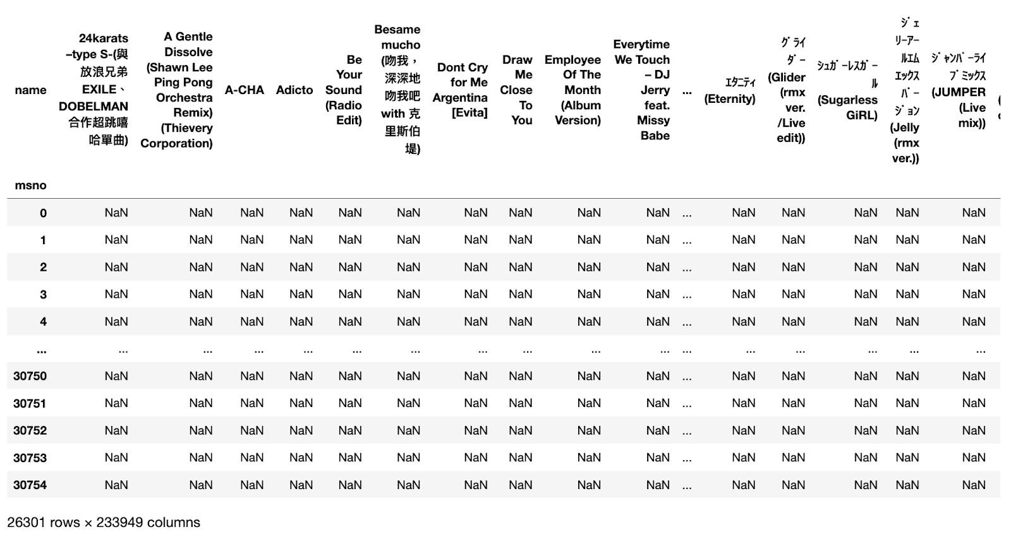
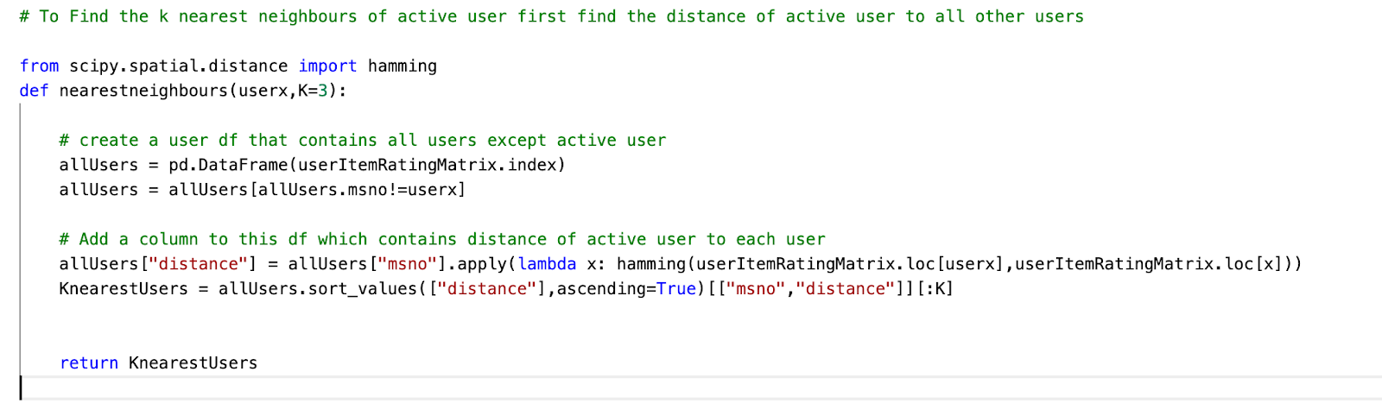
CODE SHARING KKBOX - Collaborative Filtering RS

Slide 12
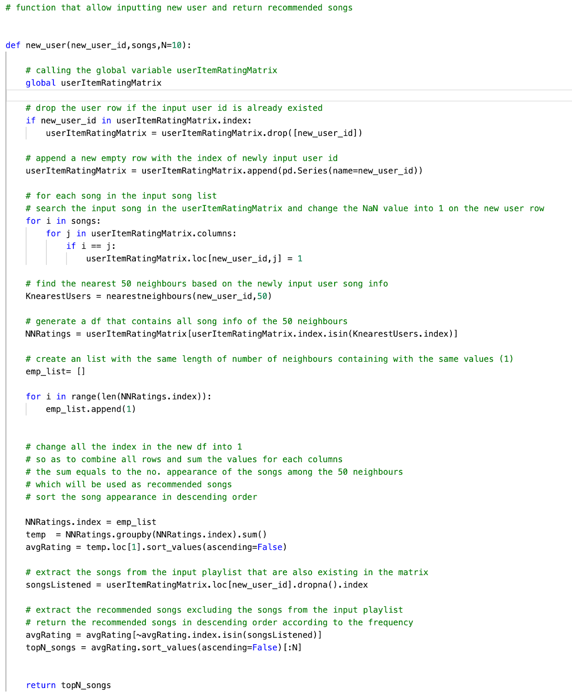
CODE SHARING KKBOX - Collaborative Filtering RS

Slide 13
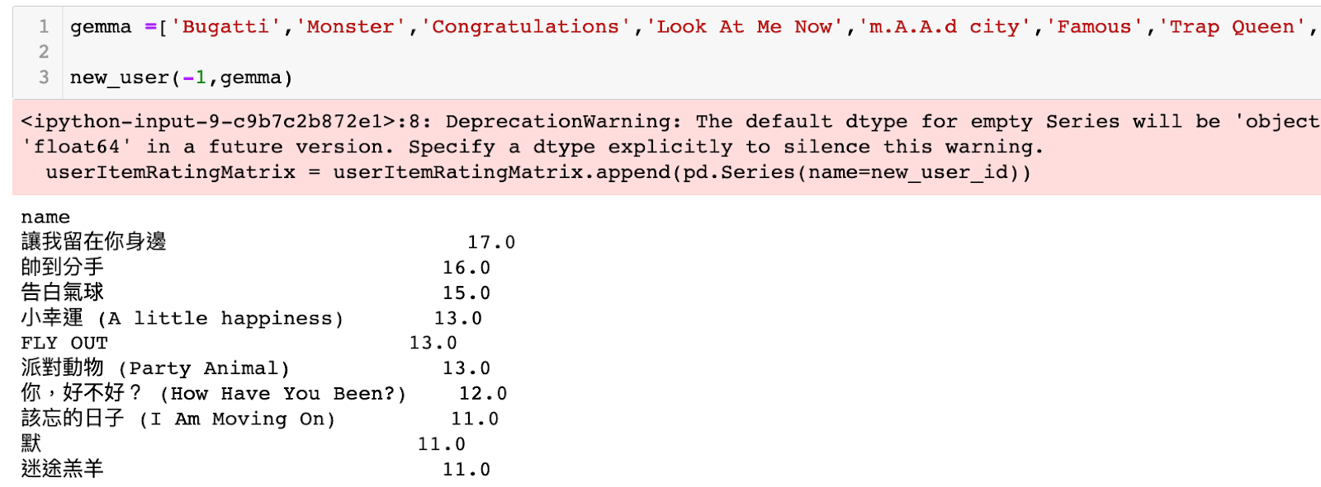
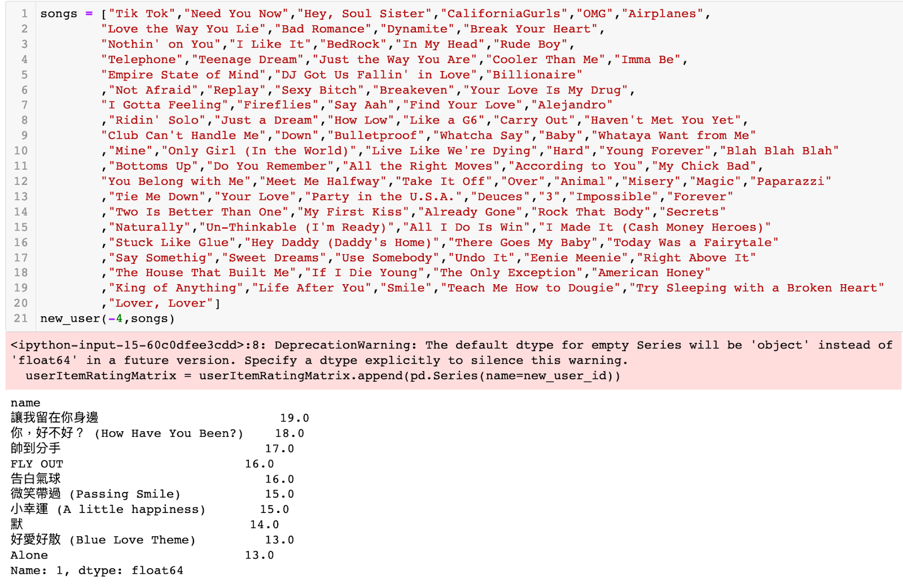
CODE SHARING KKBOX - Collaborative Filtering RS

Slide 14
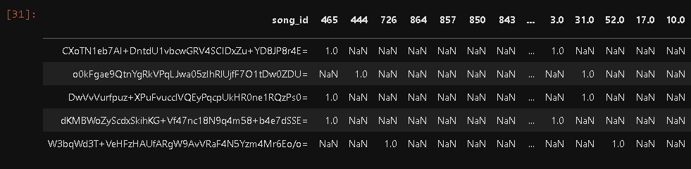
CODE SHARING KKBOX - Content Based RS

Slide 15
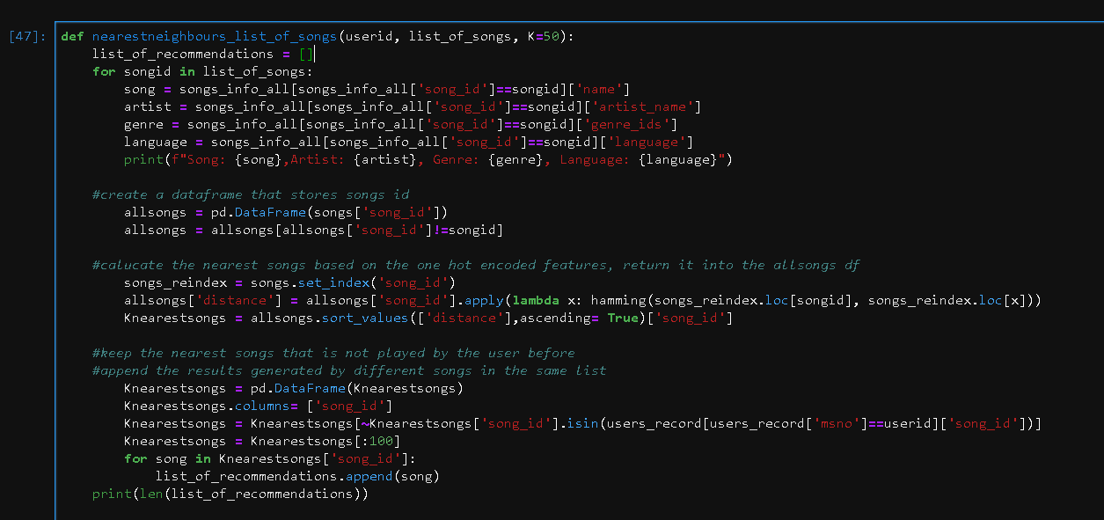
CODE SHARING KKBOX - Content Based RS

Slide 16
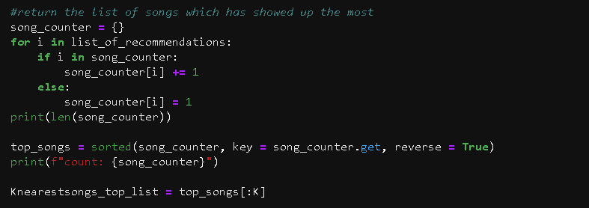
CODE SHARING KKBOX - Content Based RS

Slide 17
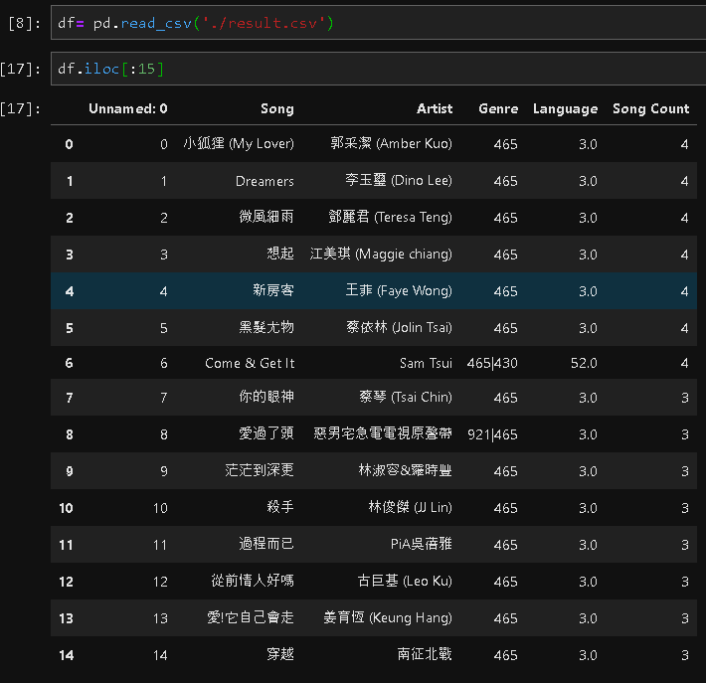
CODE SHARING KKBOX - Content Based RS

Slide 18
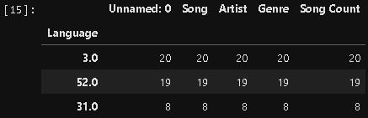
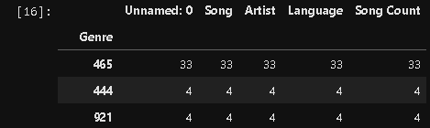
CODE SHARING KKBOX - Content Based RS

Slide 19
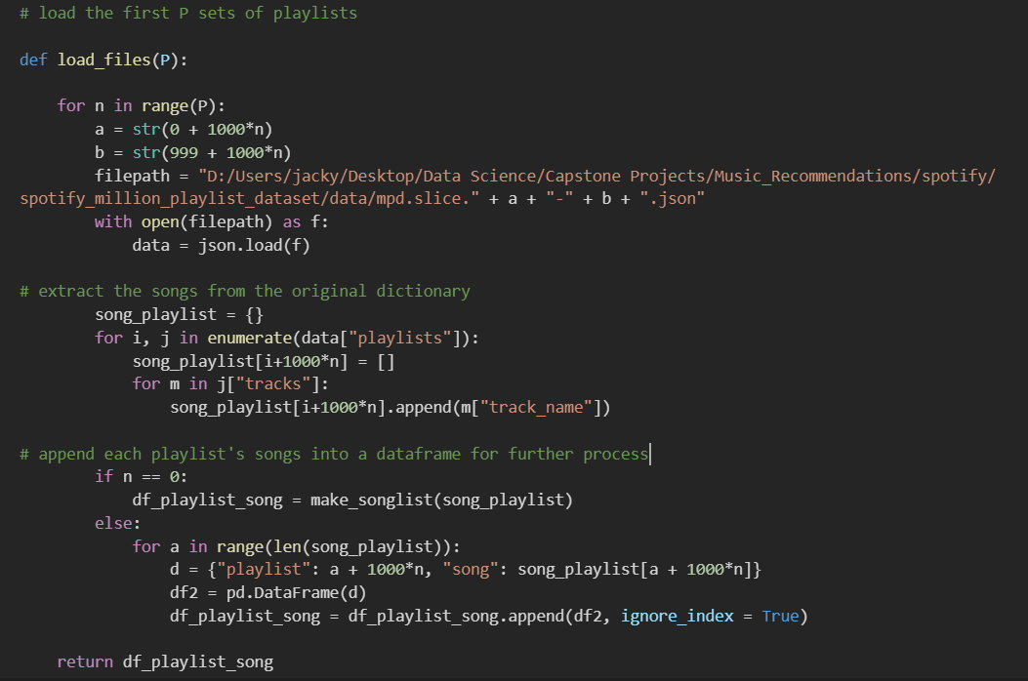
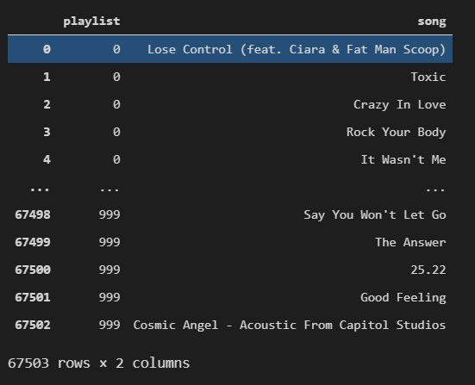
CODE SHARING SPOTIFY – Collaborative Filtering RS

Slide 20
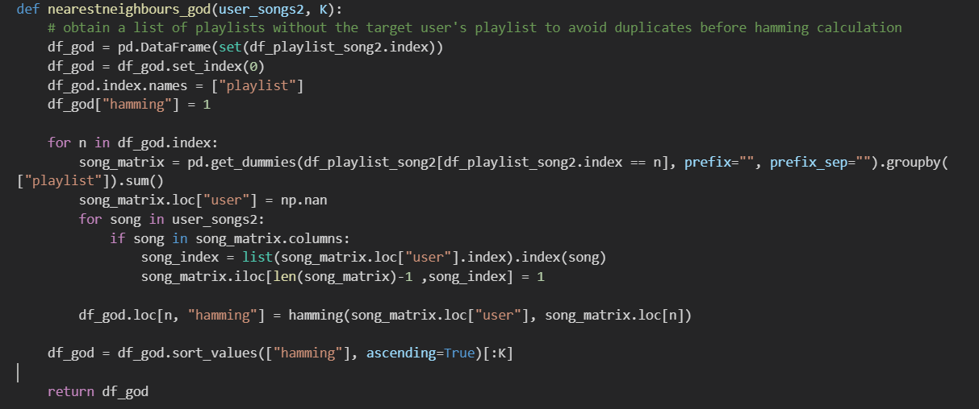
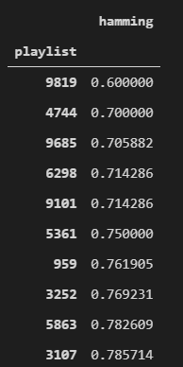
CODE SHARING SPOTIFY – Collaborative Filtering RS

Slide 21
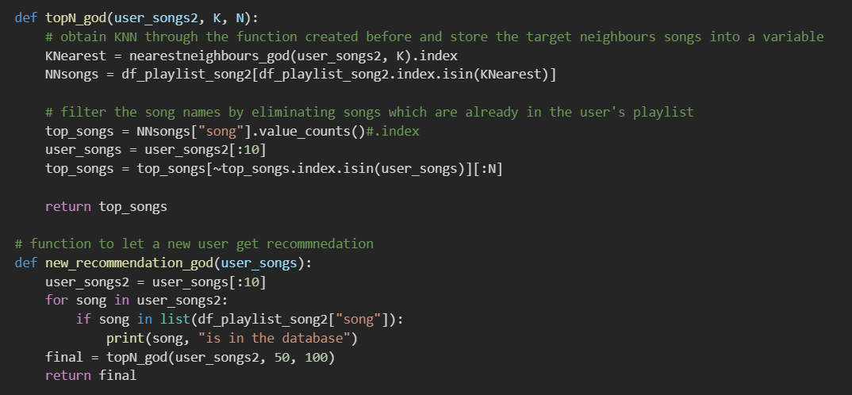
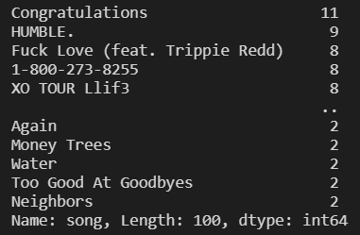
CODE SHARING SPOTIFY – Collaborative Filtering RS

Slide 22
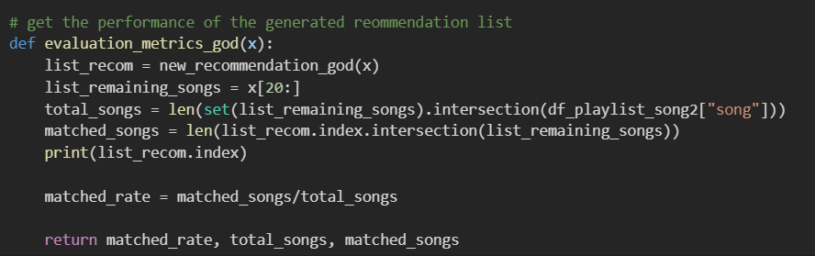
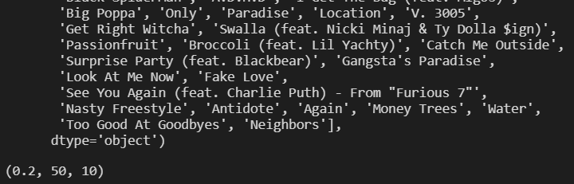
CODE SHARING SPOTIFY – Collaborative Filtering RS

Slide 23
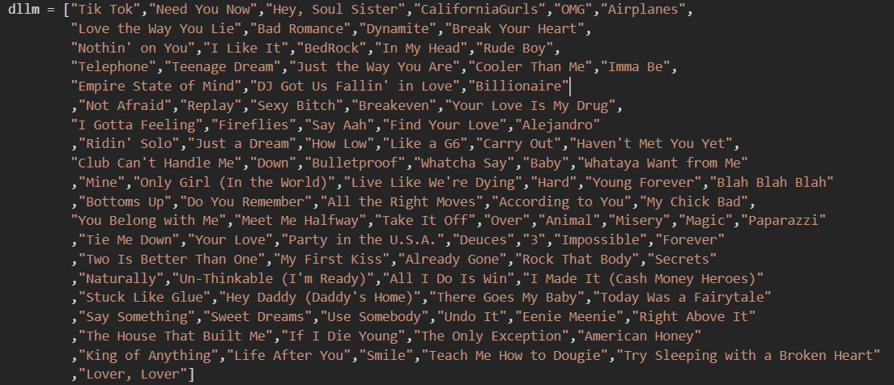
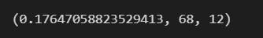
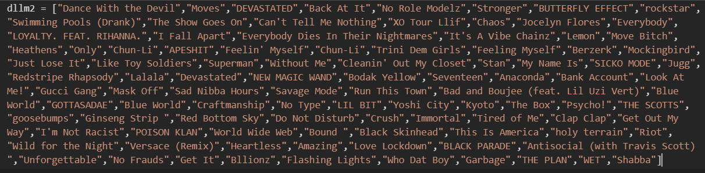

EVALUATION
Billboard 2020 Top 100 songs
17.6% match rate!
Gemma’s playlist with 100 songs
20% match rate!

Slide 24
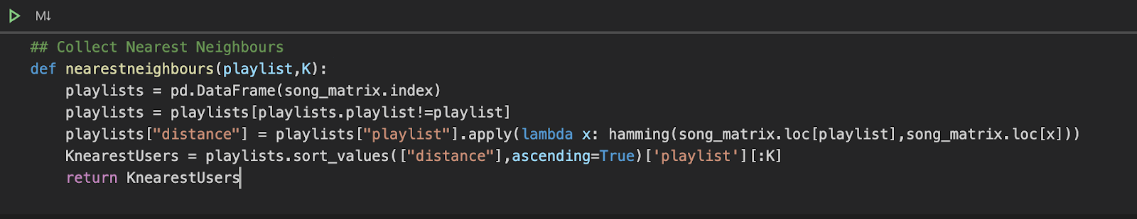
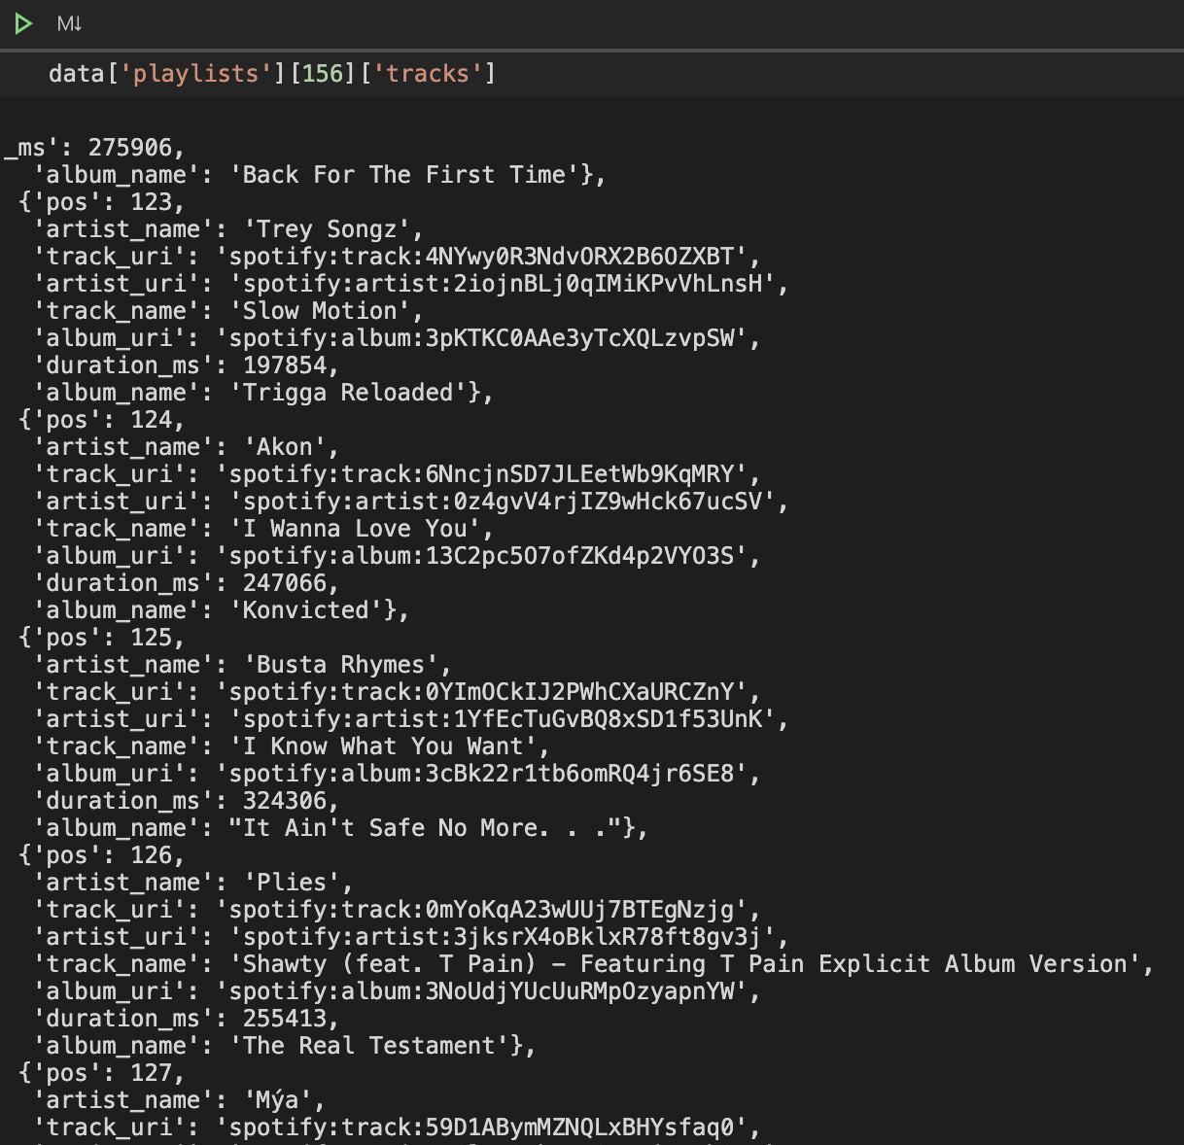
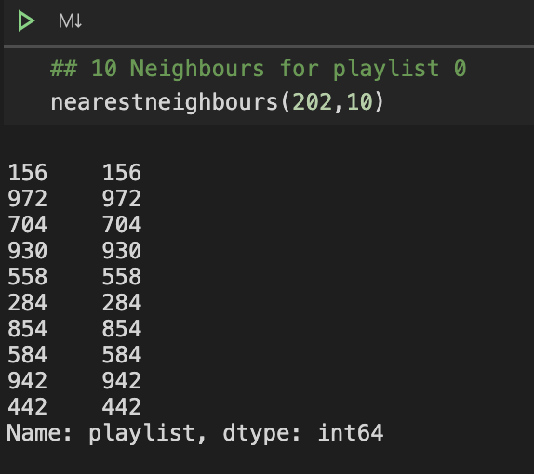
EVALUATION

Slide 25
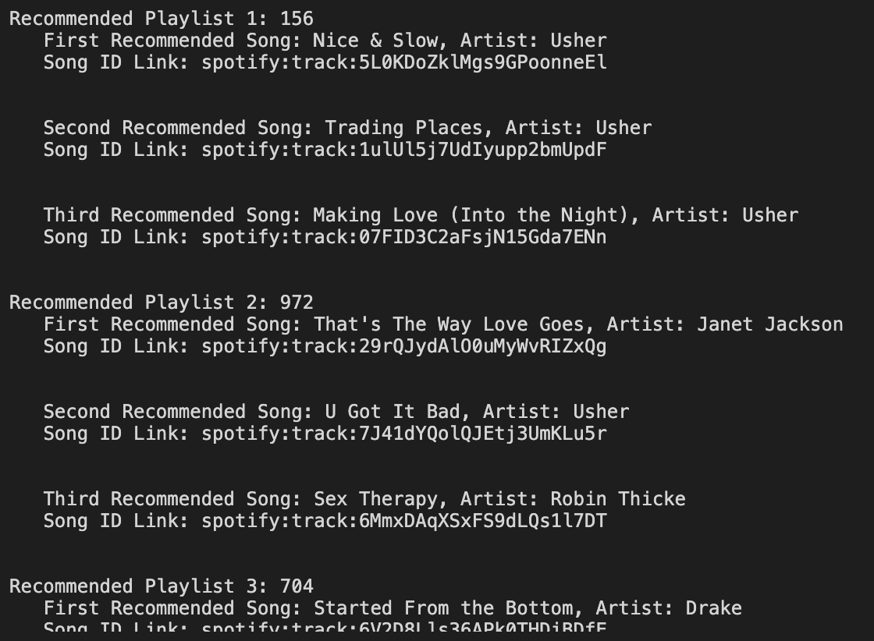
EVALUATION

Slide 26

03
LIMITATIONS
What are the flaws of our RS?

Slide 27

LIMITATIONS
Large Dataset
Insufficient computation power to process large dataset
Privacy
Lack of real user’s data for tailor-made songs recommendation or comparison
Limited Data
Only include songs that users have listened once and more than once
Effectiveness
Failed to compare effectiveness between two platforms’ RS

Slide 28

FUTURE IMPROVEMENTS & CONCLUSION
04
What can be improved in the future?

Slide 29
FUTURE IMPROVEMENTS
3. Soundwave
Analysing
soundwave as sentiment analysis
1. NLP
5. Chatbot
Interactive chatbot for users to explore new songs/genre
Analysing lyrics and song names
as features in
Content-based RS
2. Weights
4. Insights for users
higher weight from nearer neighbours
Auto-generate report with user-related insights

Slide 30


CONCLUSION
Recommended song list from KKbox leans heavily from same genres, artists and languages while Spotify’s Discover Weekly is more diversified
Our homemade Spotify recommendation systems can reach up to 20% “hit-rate” which shows a high potential for it to drive engagement
Other music platforms should definitely learn from Spotify “Discover Weekly” to cater users who want to explore new songs
KKbox mostly relies on content-based filtering while Spotify utilizes heavily on collaborative filtering to recommend songs

Slide 31

05
THOUGHTS & DISCUSSION

Slide 32

THOUGHTS & DISCUSSION
Examples:
1. social media (eg. Cambridge Analytics)
2. state-controlled environment
3. Career path hindrance
Accuracy
Accuracy
Potential Crisis:
- echo chamber effect
- spoon-fed and narrow horizons
- comfort zone vs adventurous
- personality matters
- revenues vs social responsibilities
- where is the sweet spot?
- dilemma for all data scientists
Diversity
Diversity

Slide 33

THANKS
THANKS
Does anyone have any questions?

Slide 34
CREDITS
This is where you give credit to the ones who are part of this project.
Presentation template by Slidesgo
Icons by Flaticon
Infographics and images by Freepik
Author introduction slide photo created by Freepik
Text & Image slide photo created by Freepik.com

